Slide 1
Meeting 9
Tuesday 13/03/2018

Slide 2
Agenda
LES data
Rotor averaged wind speed
Comparison BEACon & LES data
Comparison data & PARK model

Slide 3
Cases
Case 1
11,8 m/s
Wind direction aligned with wind farm lay-out
Case 2
9,0 m/s
Wind direction not aligned with wind farm lay-out
Case 3
9,5 m/s
Wind direction aligned with wind farm lay-out

Slide 4
LES data
New data available
Spatial averaged: grid spacing 25 m
Time averaged
T = 10 min
Sampling every 1 min
Moving window with 10 s

Slide 5
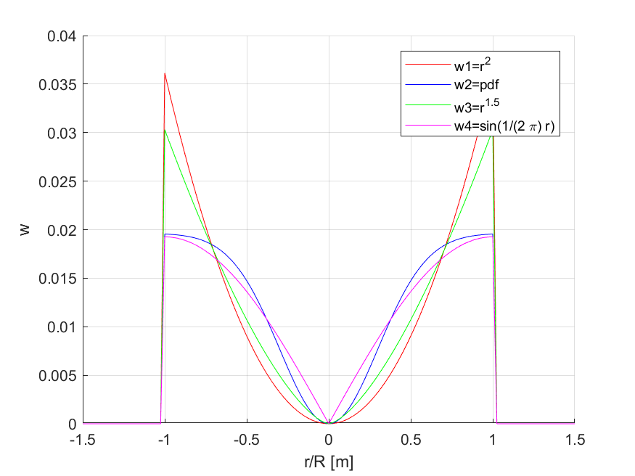

Rotor averaged wind speed
$w_{1}=r^{2}$ $w_{2}=pdf$ $w_{3}=r^{1,5}$ $w_{4}=sin⁡(\frac{π}{2}r)$

Slide 6
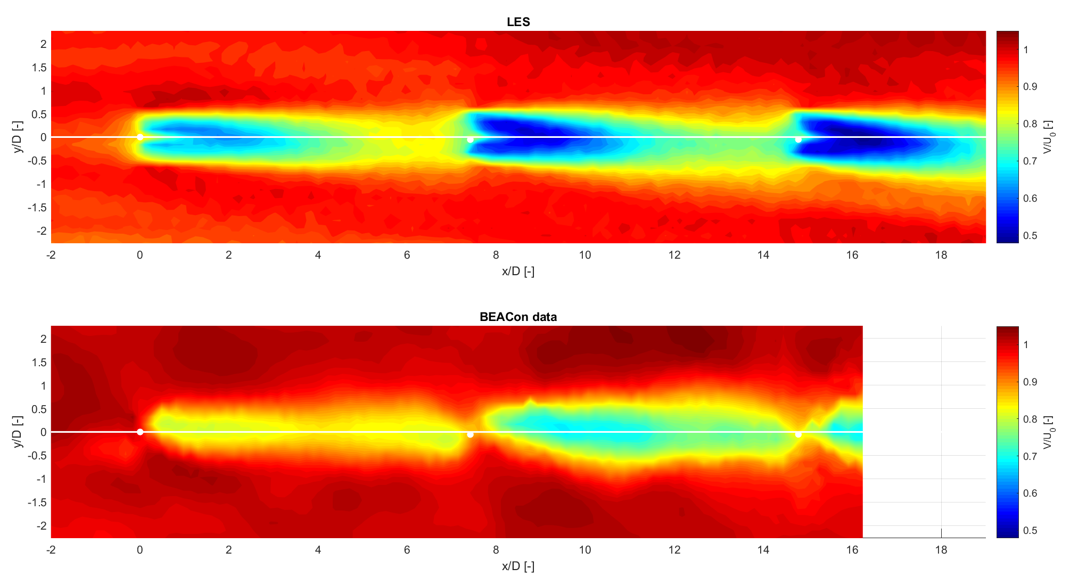
BEACon & LES data (Case 1)
Data at 100m height

Slide 7
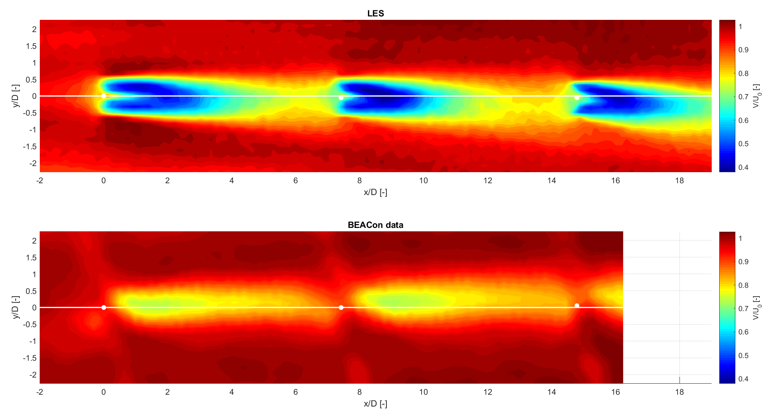
BEACon & LES data (Case 3)
Data at 100m height

Slide 8
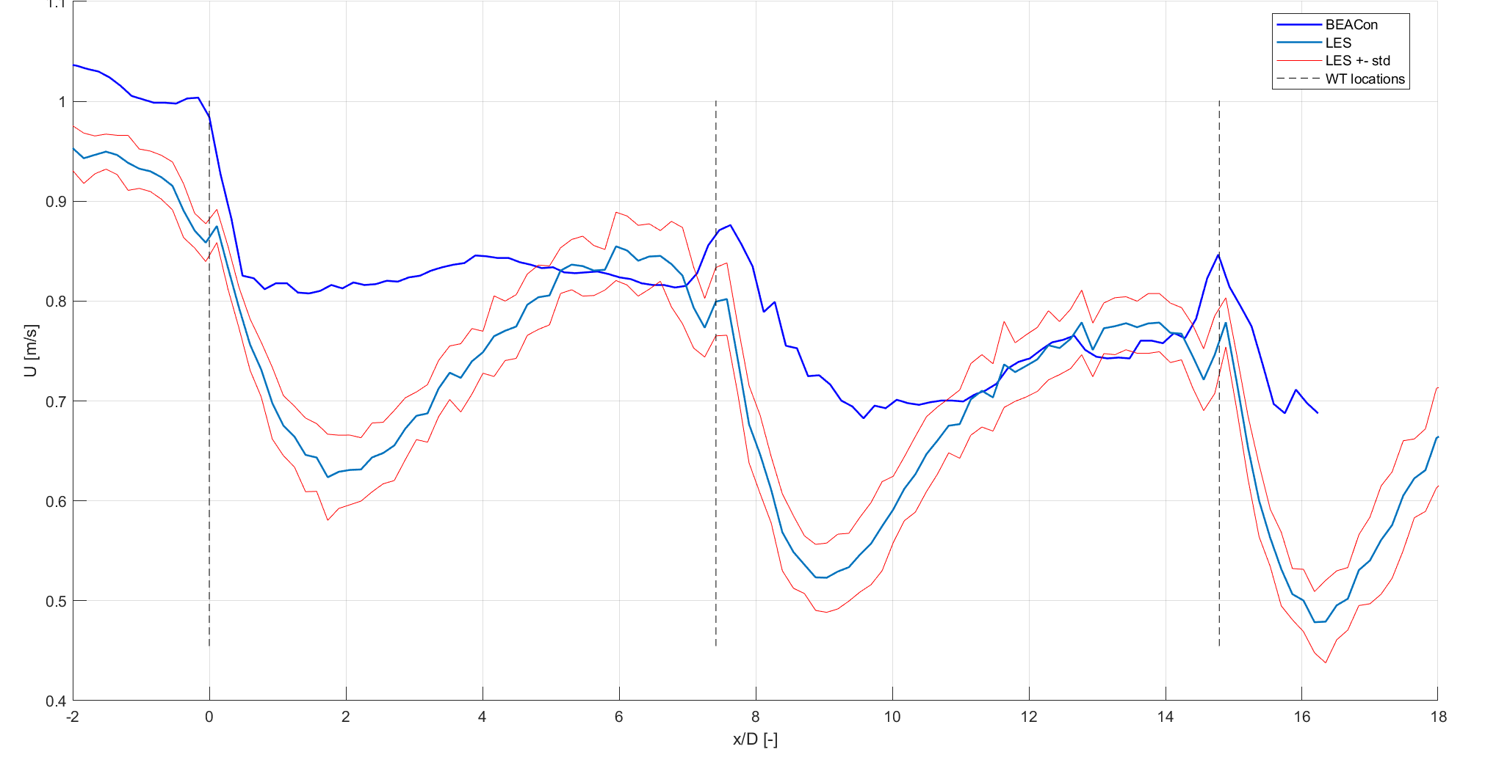
Velocity along line (Case 1)
Data at 100m height

Slide 9
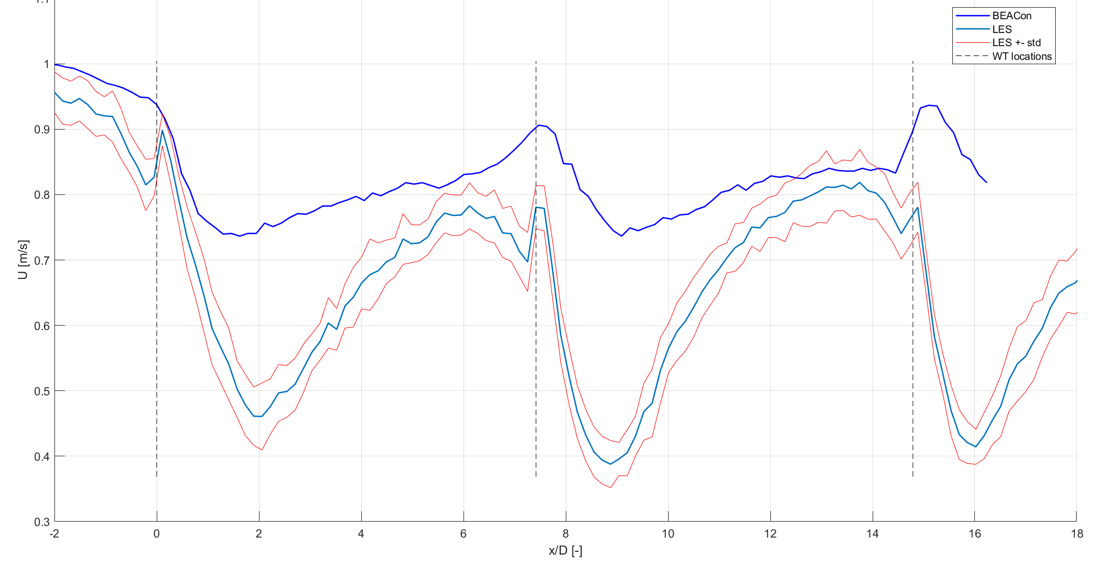
Velocity along line (Case 3)
Data at 100m height

Slide 10
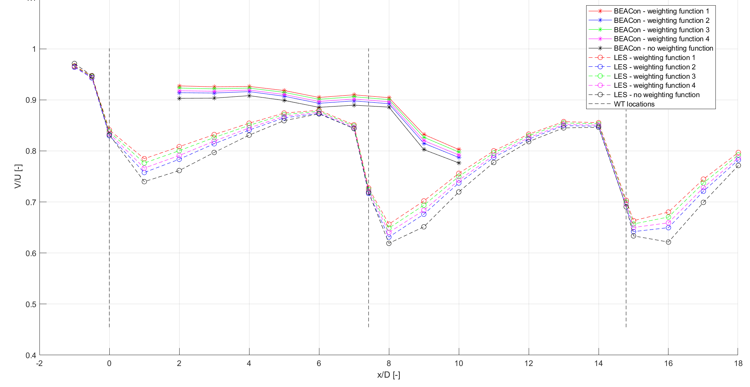
Rotor averaged wind speed (Case 1)

Slide 11
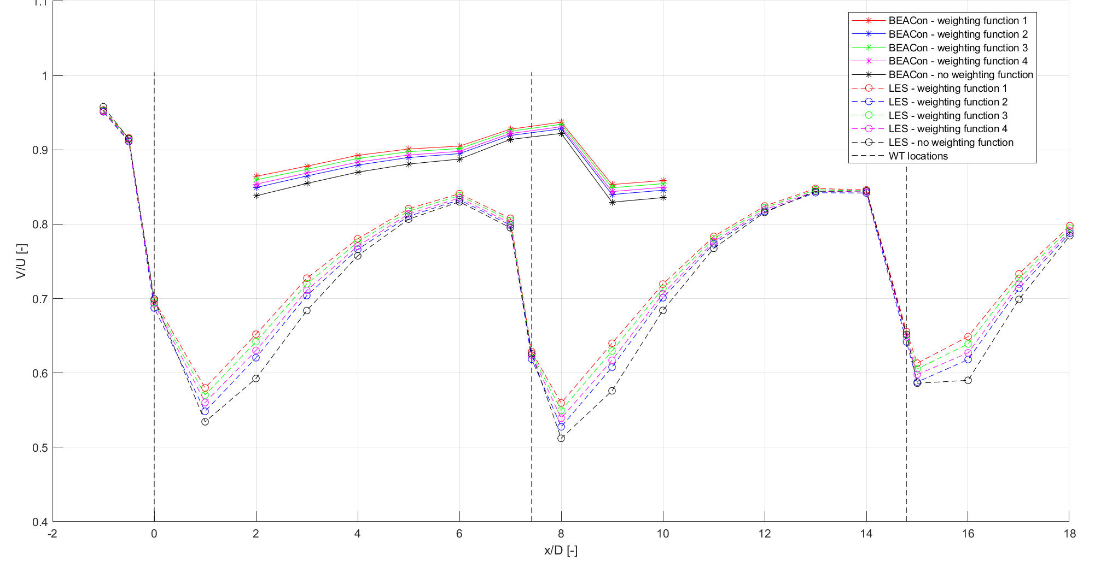
Rotor averaged wind speed (Case 3)
Fuga
Park

Slide 12
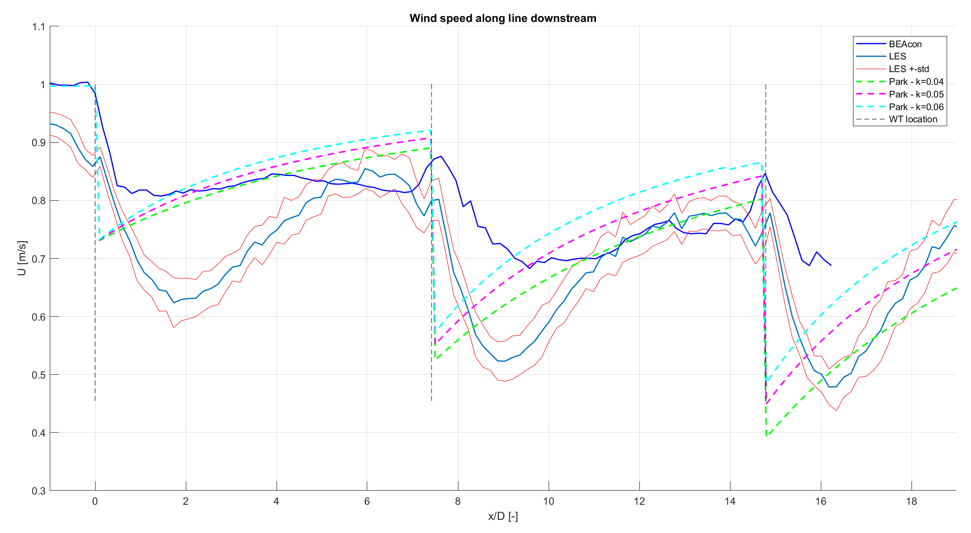
Comparison data & Park (Case 1)
Data at 100m height Park: quadratic superposition, with correction factor and wake reflection

Slide 13
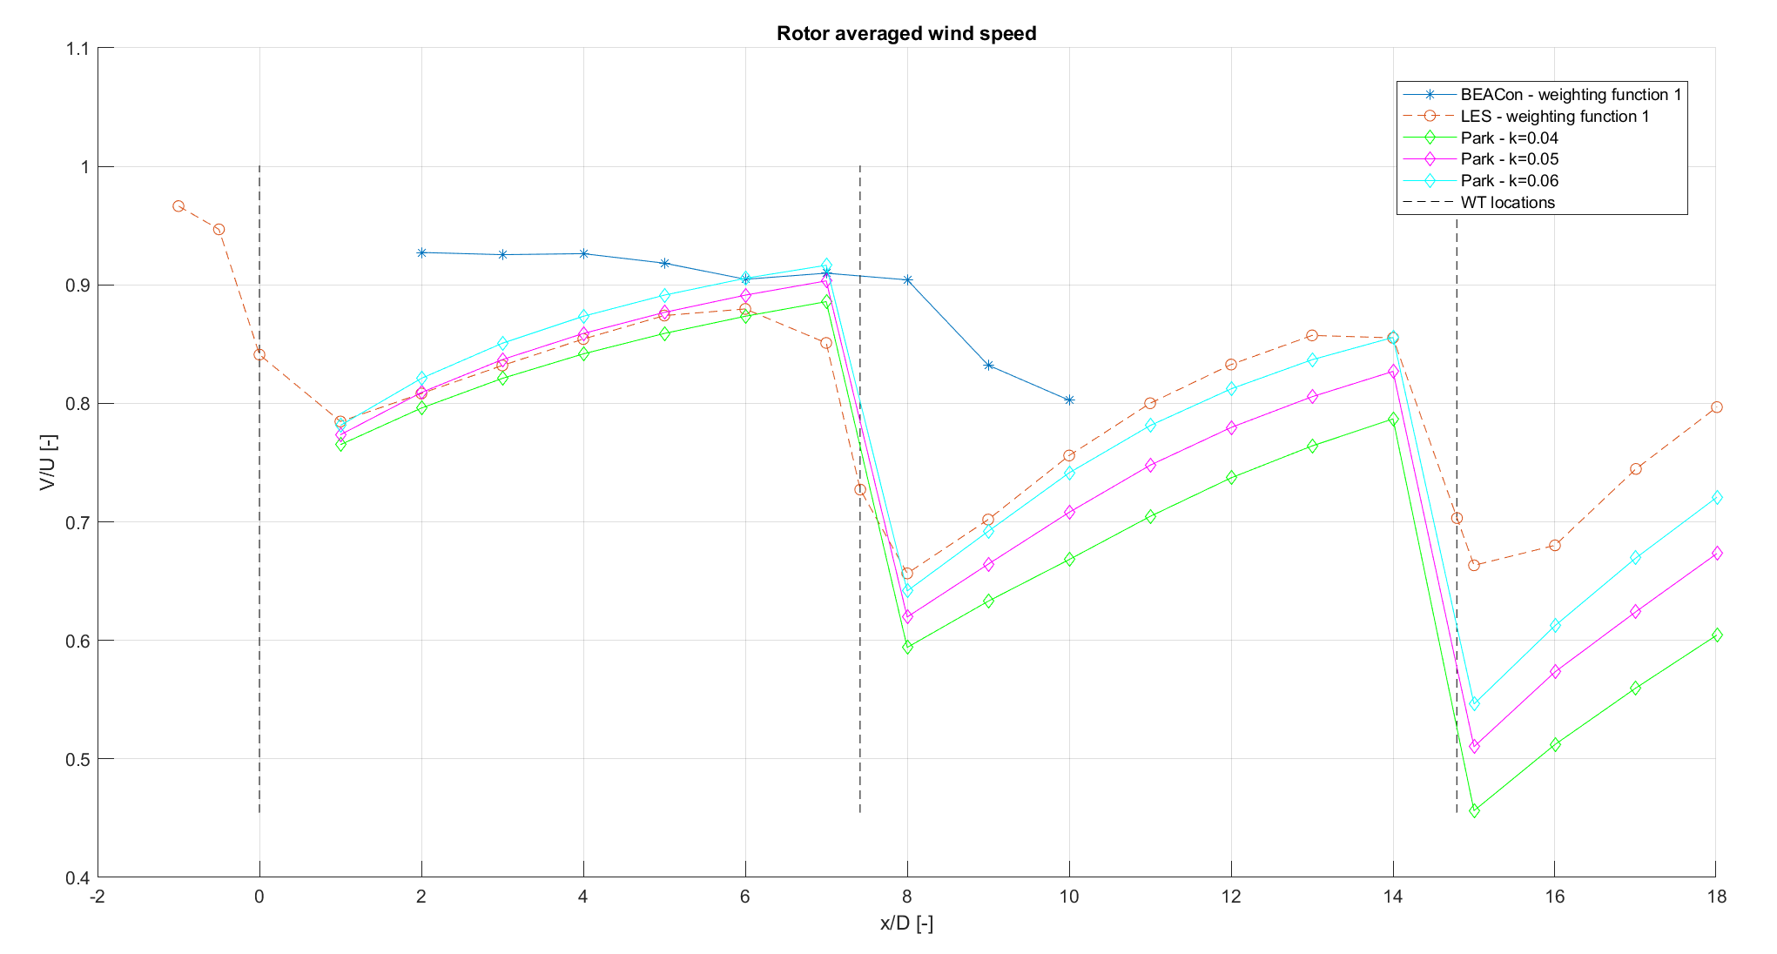
Comparison data & Park (Case 1)
Park: quadratic superposition, with correction factor and wake reflection

Slide 14
Fuga results
Velocity along line
Full wind farm
Only 3 wind turbines

Slide 15
To Do
Superposition with LES data
Calibration single wake against LES or BEACon data?
Calibration for every case?
Calibration for all cases together?

